Slide 1
MemToolbox Tutorial Suchow, J. W., Brady, T. F., Fougnie, D., & Alvarez, G. A. (2013). Modeling visual working memory with the MemToolbox. Journal of Vision, 13(10):9, 1–8. doi:10.1167/13.10.9.
Qingqing Yang, qy775@nyu.edu
Department of Psychology

Slide 2
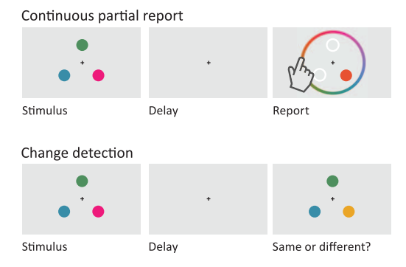
Visual WM
Working memory is a storage system that actively holds information in mind and allows for its manipulation (Baddeley, 1986).
Paradigms predominate visual WM study:
The observer sees the stimulus display, and after a delay is asked to report the color of a single item or subset
The observer sees the stimulus display, and after a delay is asked to report whether the test display matches
Suchow, J. W., Brady, T. F., Fougnie, D., & Alvarez, G. A. (2013). Modeling visual working memory with the MemToolbox. Journal of Vision, 13(10):9, 1–8, http://www.journalofvision.org/content/13/10/9, doi:10.1167/13.10.9.

Slide 3
Models proposed
Models have been proposed that link performance in 2 tasks to the architecture and capacity of the WM system.
Each model specifies the structure of visual memory and the decision process used to perform the task.
Item-limit model (Pashler, 1988)
slot model (Luck & Vogel, 1997; Cowan, 2001)
slots + averaging model (Figure 2; Zhang & Luck, 2008)
slots + resources model (Awh, Barton, & Vogel, 2007)
Continuous resource model (Wilken & Ma, 2004)
resources + swaps model (Bays, Catalao, & Husain, 2009)
Ensemble statistics + items model (Brady & Alvarez, 2011)
Variable precision model (Fougnie, Suchow, & Alvarez, 2012; van den Berg, Shin, Chou, George, & Ma, 2012;).

Slide 4
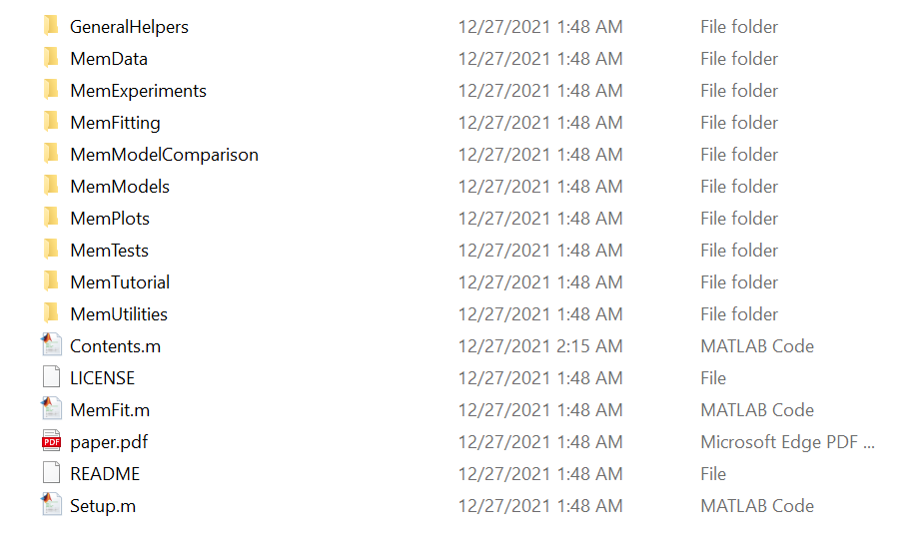
Intro of Memtoolbox
A collection of MATLAB functions for modeling visual working memory. MemToolbox (visionlab.github.io)
the toolbox includes:
Implementations of popular models of visual working memory
Real and simulated data sets
Bayesian and maximum likelihood estimation procedures for fitting models to data
Model comparison metrics
experiment scripts

Slide 5
Models in Memtoolbox
>> help MemModels
To check any model m, >>help m; to view the code, >> edit m;
% One component models:
% AllGuessingModel - only guessing
% NoGuessingModel - just precision, no guessing
%
% Mixture models for a single set size:
% StandardMixtureModel - guess rate and precision
% SwapModel - guess rate, precision and swaps to other items.
% VariablePrecisionModel - guess rate and variable precision
% EnsembleIntegrationModel - integration with distractors shifts reports
%
% Models parameterized based on set size:
% SlotModel - capacity and precision (no benefit when cap.>setsize)
% SlotsPlusResourcesModel - capacity and precision (more juice when cap.>setsize)
% SlotsPlusAveragingModel - capacity and precision (more slots/item when cap.>setsize)
% ContinuousResourceModel - capacity juice split among all items equally
%
% Models that depend on delay duration:
% ExponentialDecayModel - capacity K and sd, plus objects drop out over time
%
% Model wrappers:
% WithBias - adds a bias terms (mu) to any model
% FixParameterValue - fix any parameter in a model to a specific value
% Orientation - converts a model to use a 180 degree space, for objects rotationally symmetric
% TwoAFC - converts a model so that can be fit to 2afc data
% WithLapses - adds inattentional parameter to any model

Slide 6
Set up
Download from MemToolbox (visionlab.github.io)
Add the files to Matlab
Manually
Run setup.m

Slide 7
Modeling in standard workflow
picks a model
fit the model to data using probabilistic methods
Given a model M with free parameters θ, the model’s likelihood function specifies a probability distribution P(θ|D) (integral = 1) over likelihood P(D|θ).
a likelihood function is defined, describes the model’s predictions for each possible setting of its parameters.
an estimator is used to pick the parameter settings that provide the best fit to the data. maximum likelihood estimator or maximum a posterior estimate is often used.

Slide 8
Modeling in standard workflow
2 structs to organize the info:
the model and its likelihood function
the data to be fit
Fitting is simply call a build in function:
MemFit(), this will return the MAP estimate of parameters
MLE(), this will return the MLE parameters
>>model = StandardMixtureModel();
>>data.errors = [-89, 29, -2, 6, -16, 65, 43, -12, 10, 0, 178, -42, 52, 1, -2];
>>fit = MLE(data, model) Or MemFit(data.errors)

Slide 9
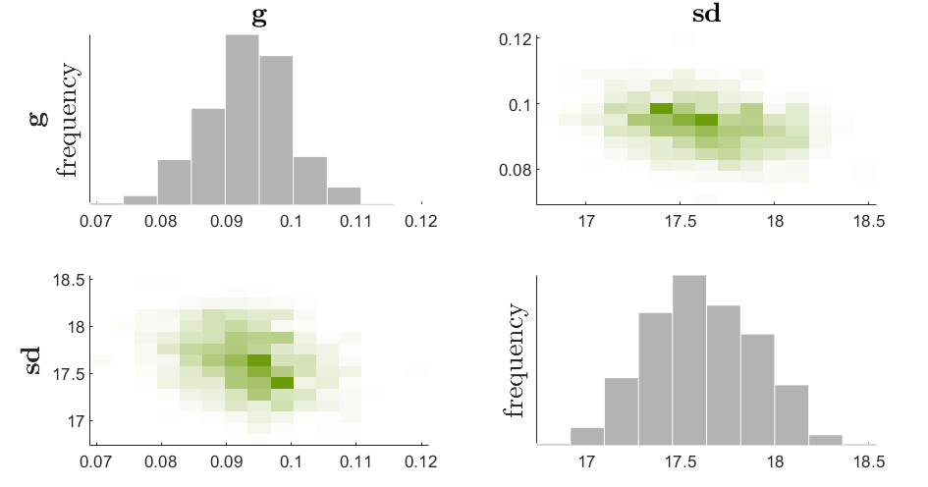

Bayesian Workflow
Instead of just returning the MLE/MAP estimate, the toolbox uses a Bayesian workflow constructs a full probability distribution over parameter values. Have reasonableness of every possible parameter setting after considering the observed data as prior beliefs.
>> fit = MemFit(data, model)
Or >> get posterior sample from MCMC(data, model);
The prior, P(θ) conveys which parameter values are reasonable.
Once specified the P(θ), beliefs are updated based on the experimental data. After observing data D, the posterior beliefs about parameters (‘‘the posterior’’) are given by

Slide 10
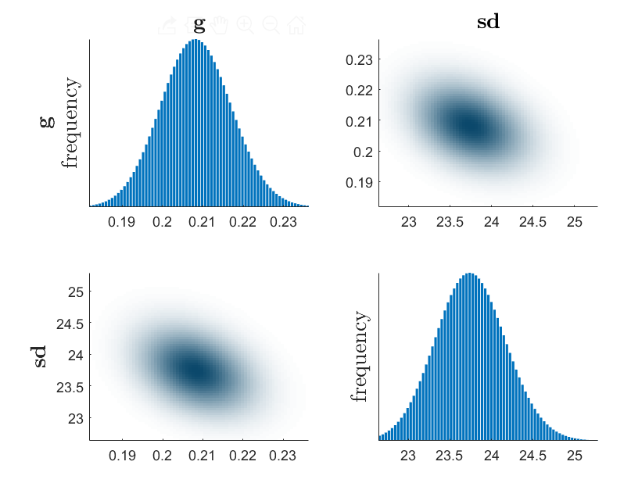
Bayesian Workflow
To estimate the full posterior distribution, sampling-based algorithms are used.
The Metropolis-Hastings variant of Markov Chain Monte Carlo (MCMC):
The algorithm chooses an initial set, over many iterations, proposes small moves to these parameter values, accepting or rejectiof model parametersng them based on how possible the new parameter values are in both the prior and the likelihood function.
GridSearch function: evaluating the model’s likelihood and prior at every possible setting of the parameters
The full posterior distribution also helps determine the relationship between parameters.

Slide 11
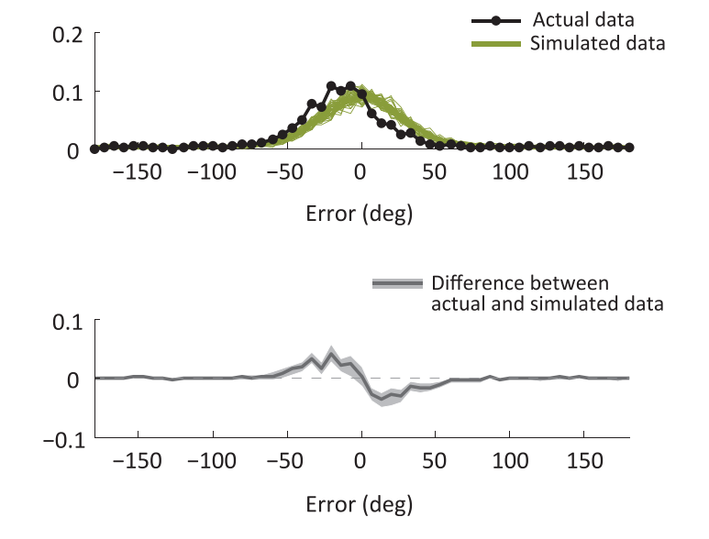
Posterior predictive checks
Sometimes a whole class of models performs poorly, such that there are no parameter settings that will produce a good fit.
Simulates new data from the posterior fit and then compares the actual and simulated data
A good fit does not necessarily indicate a good model. An extremely flexible model
models that systematically deviate in a posterior predictive check nearly always need improvement!
>>PlotPosteriorPredictiveData(model, posteriorSamples,...
data, [optionalParameters])

Slide 12
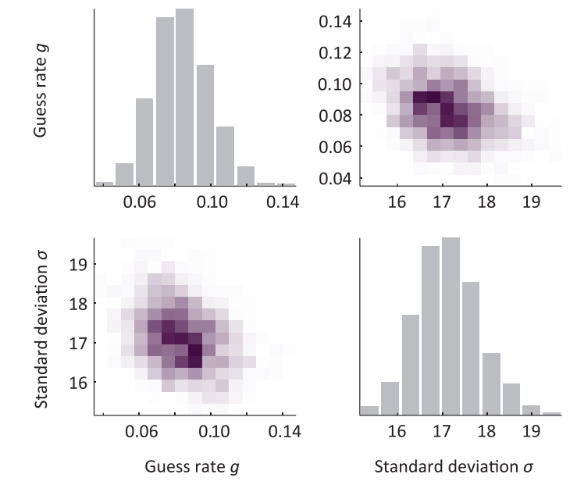
Hierarchical modeling for population
Traditional method for a population:
Fit each participant separately;
Combine parameter by median or mean;
Difference between condition – t-test, ANOVAs
Discards information about the reliability of each participant’s parameter estimates.
Trade-off between parameters

Slide 13
Hierarchical modeling
Better method: Fit a single hierarchical model of all participants
This treats each participant’s parameters as samples from a normally distributed population, and then infer the population mean and sd of each parameter.
More weight to participants whose data give more reliable parameter estimates
>> data1 = MemDataset(1);
>> data2 = MemDataset(2);
>> model = StandardMixtureModel();
>> fit = MemFit({data1,data2}, model,’UseHierarchical’, true)

Slide 14
Model comparison
Two elements to be considered:
the resemblance between the model and the data
the model’s flexibility
Approaches penalize more flexible models:
Akaike Information Criterion (AIC)) (with correction for finite data (AICc))
Bayesian Information Criterion (BIC)
Deviance Information Criterion (DIC) for hierarchical setting
Bayes factor
Log likelihood
>> model1 = StandardMixtureModel();
>> model2 = SwapModel();
>> modelComparison = MemFit(data, {model1, model2})
Notes:
43 common era: Roman physician reported the application of electrical discharge of sea creatures for treatment

Slide 15
Model comparison
Computing the comparison metric for each participant independently and looking at consistency to make inferences about the best-fitting models
Take participants’ variance into account, therefore generalized to population, (like ANOVA over model likelihood)
However, computing a single AICC or BIC value across all participants does not allow generalization to the population

Slide 16
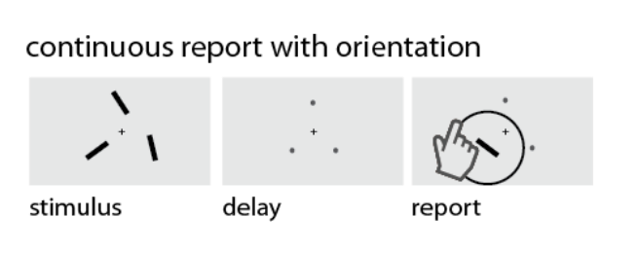
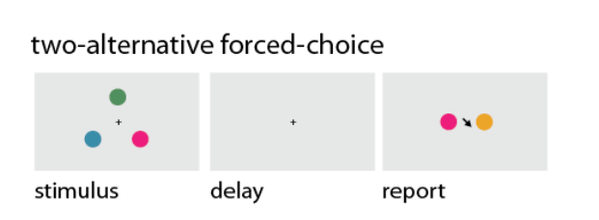
Advanced Modeling
Modeling with different type of data
Orientation data
2AFC
Modeling with different Set sizes
Comparing parameters between conditions
Fit model with 1 data but examine the model with another
Create ur own new model

Slide 17
Thank you!

